Slide 1
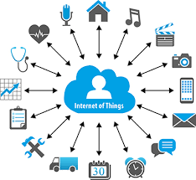

DST sponsored six days FDP on “Data Analytics in Healthcare” (17-22 January, 2022) Data Analytics using IoT Devices in Healthcare 19.1.22 – (1.00-3.30 pm)
Presented by
Dr. S. Chithra,
Associate Professor, IT
SSN College of Engineering, Chennai

Slide 2
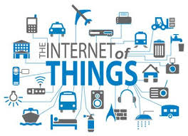
Introduction
An informational network that allows the look-up of information about real-world objects by means of a unique ID called Electronic Product Code (EPC) to a network of sensors, actuators and autonomous objects interacting with each other directly
Machine-to-machine (M2M) communication
It is related to the integration of the physical world with the virtual world of Internet.

Slide 3
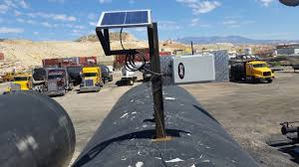
Example Scenario
Container filled with some temperature-sensitive chemical that is transported from A to B.
Its location needs to be tracked continuously, and the temperature must be monitored to ensure that it is within certain boundaries at all times.
The container is the entity of interest, and the sensor tag is the attached device.

Slide 4
Healthcare Technologies
Healthcare technologies can be regarded as the integration of technologies of medical sensors, mobile computing, and wireless communications into a system of medical assistance.

Slide 5
Application Examples
Monitoring of patient’s vital signs
Diabetes
Asthma
Hypertension
ECG
Predictive usage in order to minimize the needs for medication
Improving the quality of life

Slide 6
Potential Benefits
Increasing the physician productivity and efficiency.
Wireless sensors enable the patients’ freedom of movements and therefore promote new ways of monitoring the patient.
Providing clinicians remote access to patient’s information eliminates the need to manually locate and search through patient’s data.
Enabling telemonitoring in emergency scenarios and making remote diagnosis possible.

Slide 7
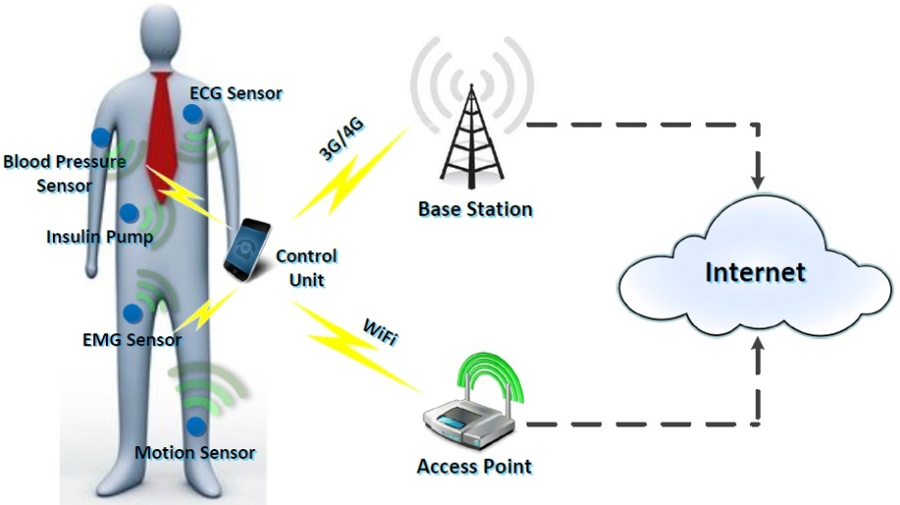
Body Area Sensor Network
Started at 1995 as Wireless Personal Area Network
Wearable or implantable sensors
Usually Bio Sensors for sensing physiological data
Routing takes place through control unit or via sensors itself (Smart Sensors)
Uses Low power chargeable battery operated circuits
Computer Assisted early detection of medical symptoms
So far used in diagnosing Cardio and Diabetic patient

Slide 8
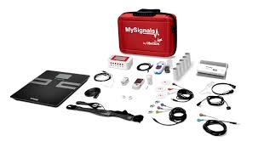
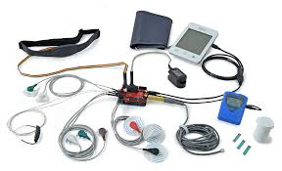
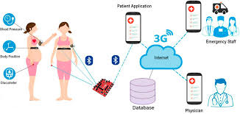
How to sense data?

Slide 9
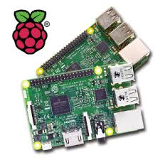
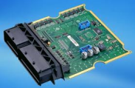
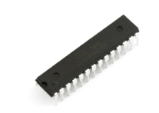
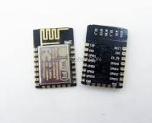
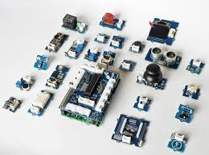
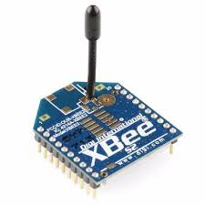
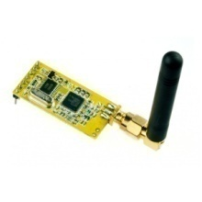
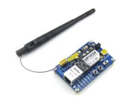
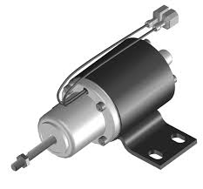
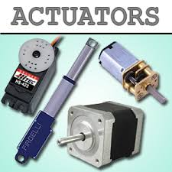
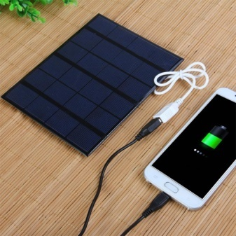
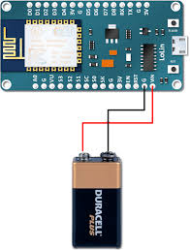
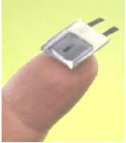
Electronic Components of IoT
Control Units
Sensors
Communication Modules
Actuators
Power Sources

Slide 10
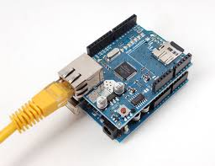
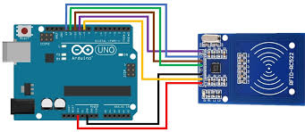
Communication Technologies
Ethernet
Wired
Low power
No Mobility
RFID
Low Cost
High Mobility
No Internet

Slide 11
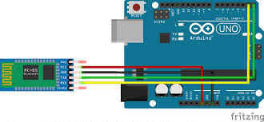
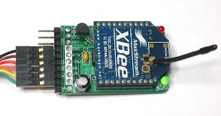
Communication Technologies
Bluetooth
- Need to be in visual line of sight
- No Internet connectivity
Automatic creation of peer networks
ZigBee
Low cost
Low power
Better range
Automatic creation of peer networks
No Internet connectivity

Slide 12
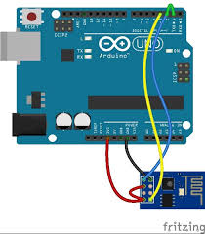
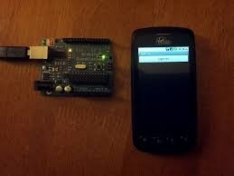
Communication Technologies
WiFi
Internet connectivity
More power
100-150 m distance coverage
Mobile Internet
GSM Shield
GPRS

Slide 13
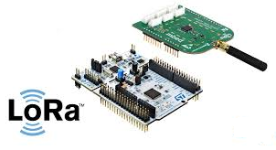
LoRa (Long Range) Technology
Connects devices up to 30 miles apart in rural areas and penetrates dense urban or deep indoor environments
Requires minimal energy, with prolonged battery lifetime
Features end-to-end AES128 encryption

Slide 14
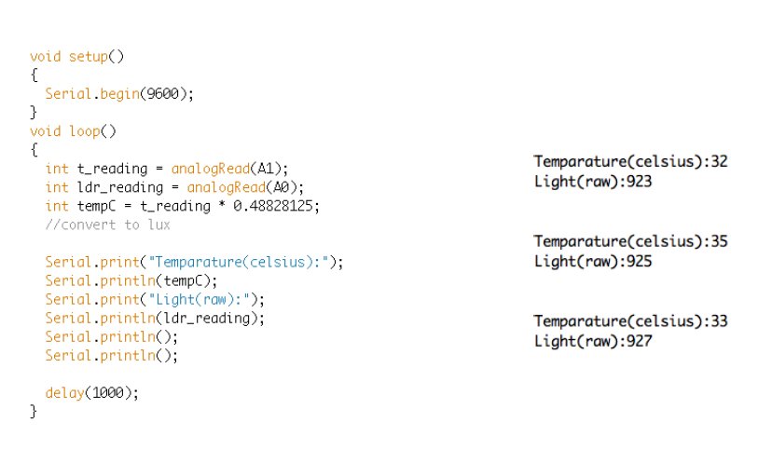
Program to read analog sensor

Slide 15
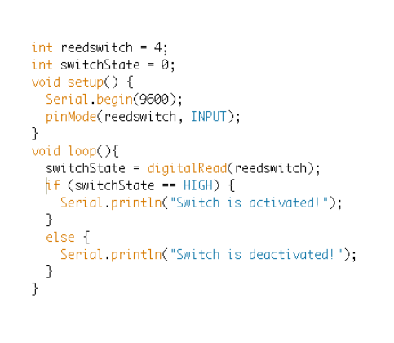
Reading from Digital sensor

Slide 16
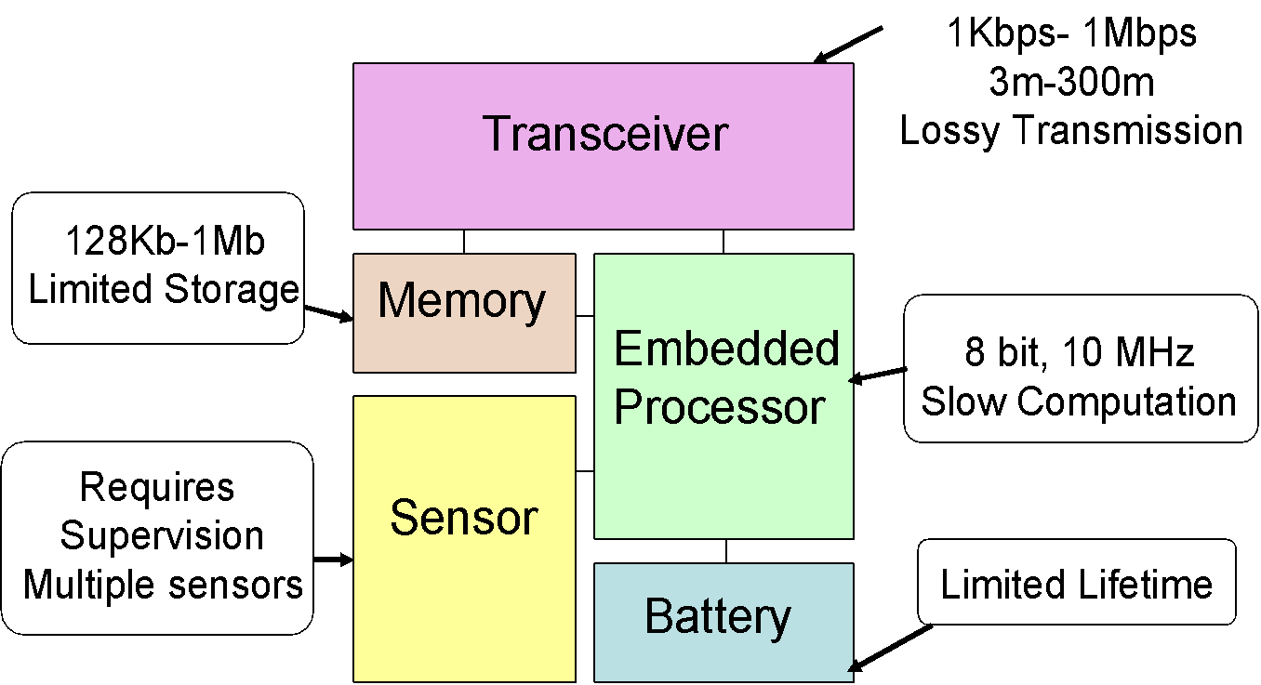
Sensor Node Hardware
Sensor + Actuator + ADC + Microprocessor + Powering Unit
+ Communication Unit (RF Transceiver) + GPS
Portable and self-sustained (power, communication, intelligence).
Capable of embedded complex data processing.

Slide 17

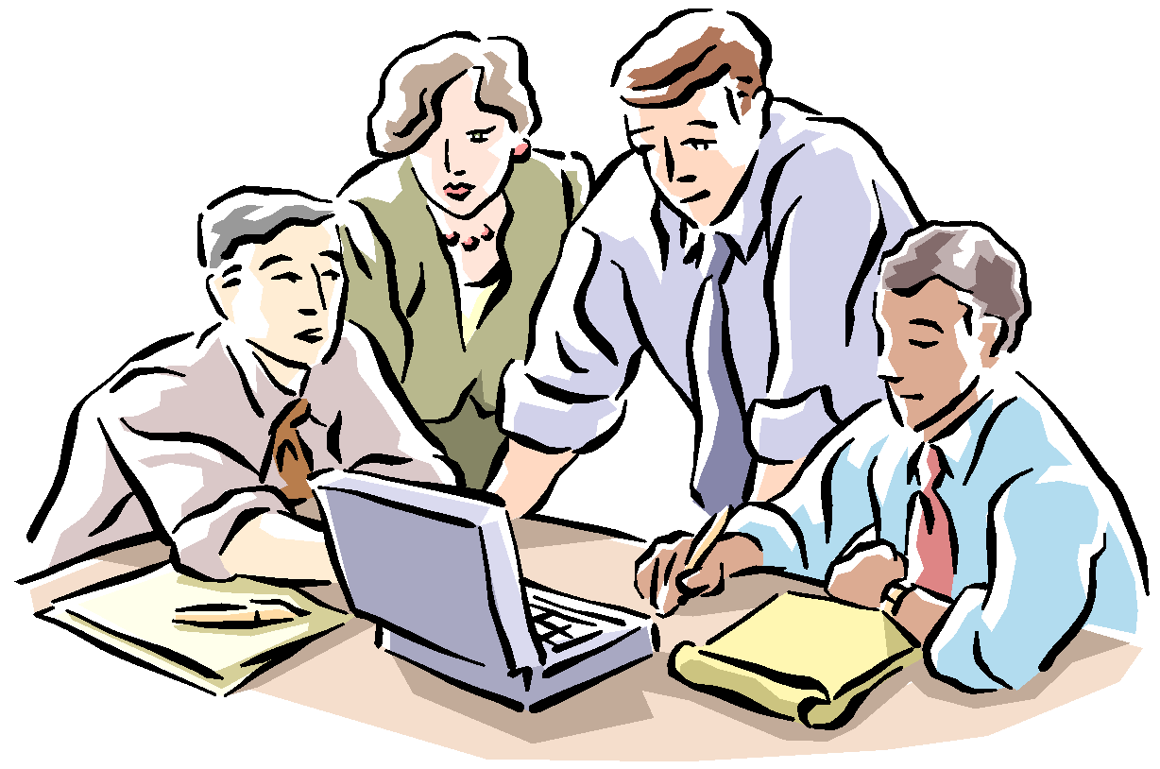
Medical and Healthcare Application
Remote
Databases
Backbone Network
Net Switch
In Hospital
Physician
Net Switch
Wireless Remote
consultation
Possibility for Remote consulting
(including Audio Visual communication)

Slide 18
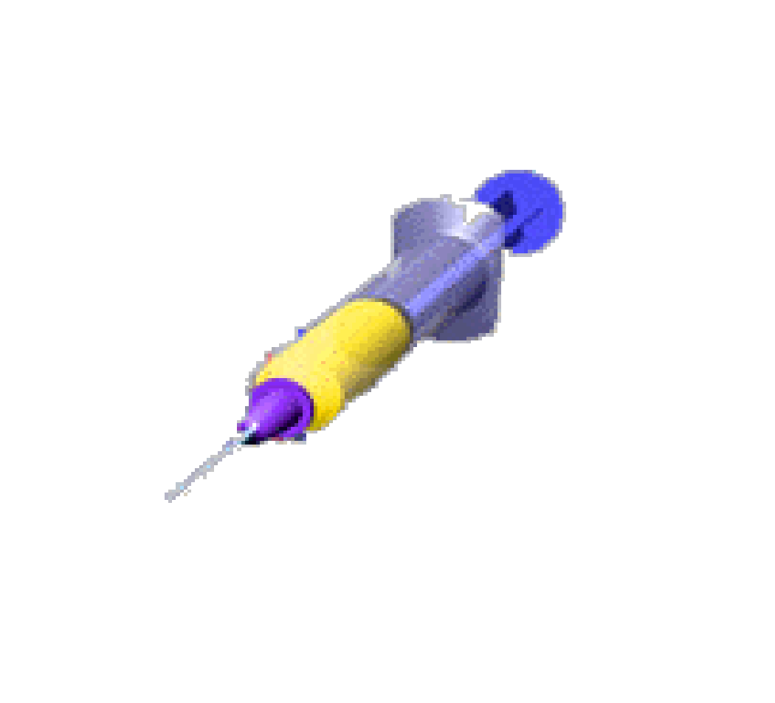
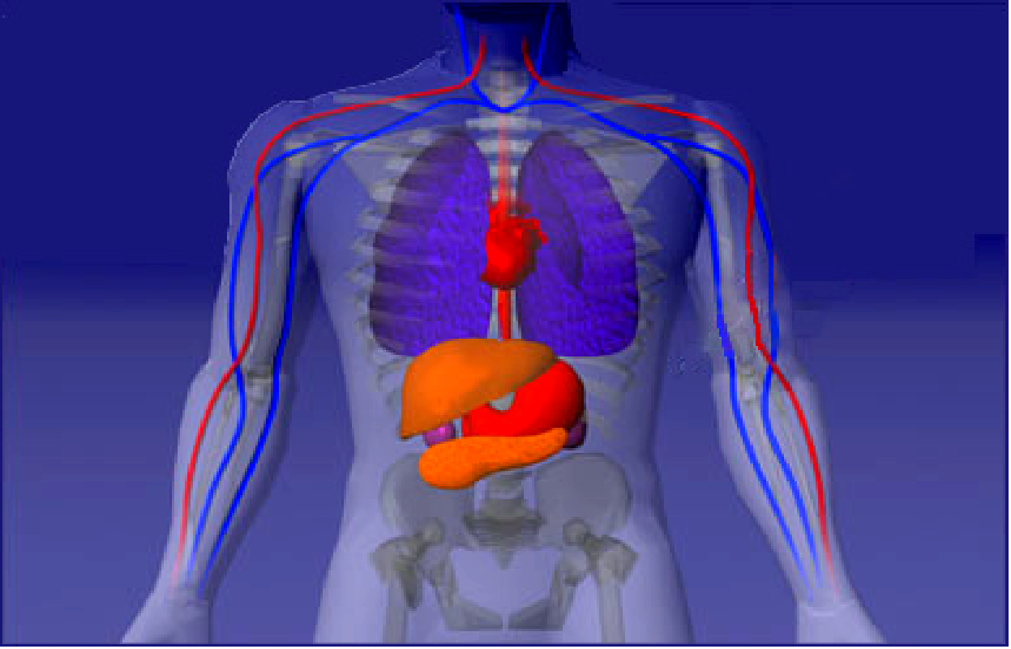
Medical Sensors
Sensors equipped
with BlueTooth

Slide 19
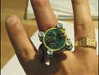
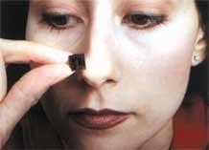
Research on medical sensors
MIT d'Arbeloff Lab (Cambridge, USA) – The ring sensor
Monitors the physiological status of the wearer and transmits the information to the medical professional over the Internet
Oak Ridge National Laboratory (USA)
Nose-on-a-chip is a MEMS-based sensor
It can detect 400 species of gases and transmit a signal indicating the level to a central control station
PMC Labs (US)
VERICHIP: Miniaturised, Implanted, Identification Technology - The VeriChip™ is a Radio-Frequency Identification (RFID) tag produced commercially for implantation in human beings.

Slide 20
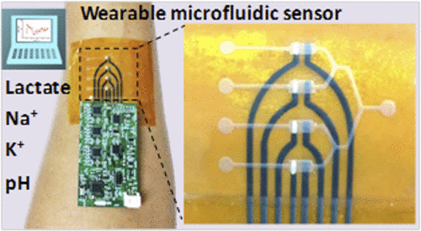
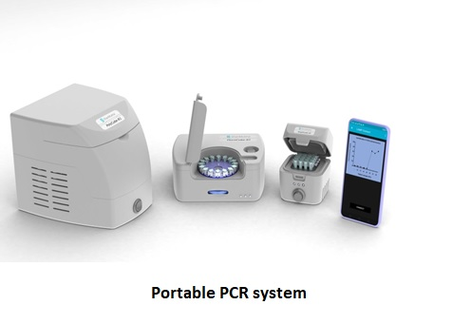
Research on medical devices in India
IIT Bombay -
Low-cost Wearable Sensors for Diagnosis of Pulse Rate Variability.
fabricated these tactile (pressure and strain) sensors using low-cost polyurethane foam and nanomaterial-based inks
CSIR-Central Electrochemical Research Institute (CECRI), Karaikudi
introduced a flexible low cost, wearable sensor that can track sweat for monitoring the health and physiological status of the human body
ICMR + IIT
The Indian Council of Medical Research (ICMR) has joined hands with Indian Institutes of Technology ((IITs)) to establish “ICMR at IITs" by setting-up Centres of Excellence (CoE) for Make-in-India product development and their commercialisation in medical devices and diagnostics space .
Meity (Centre for excellence IISC, IITB, IITM, IITD)
Diabetes, Anaemia and Malnutrition, Kidney and Liver disease Monitoring system

Slide 21
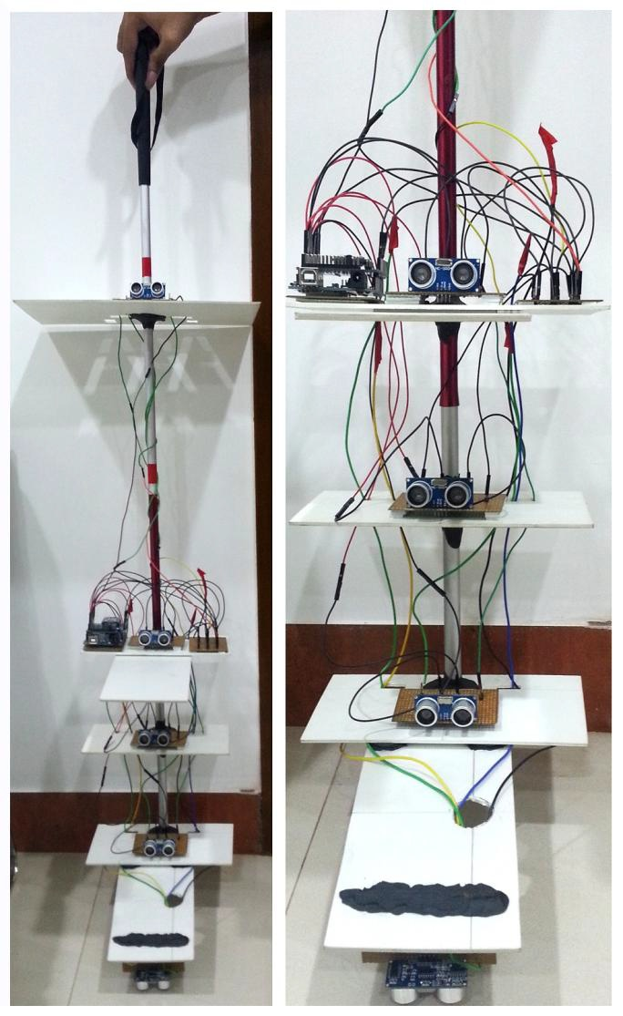
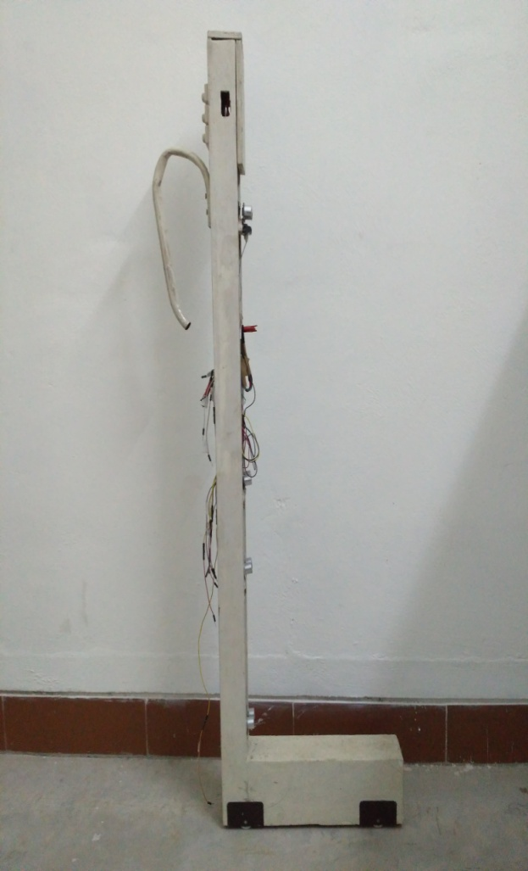
Research work at SSN on IoT in Healthcare (Smart cane for Blind)

Slide 22
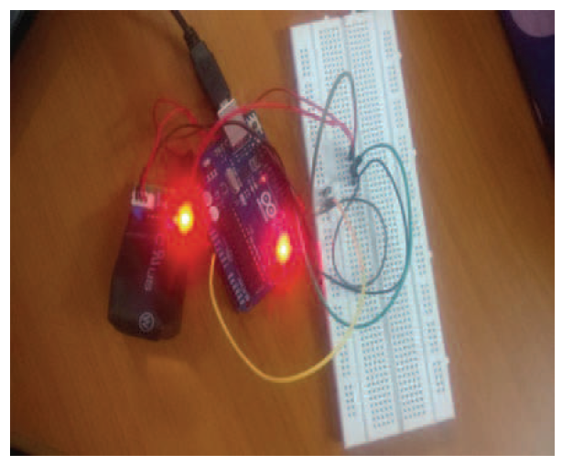
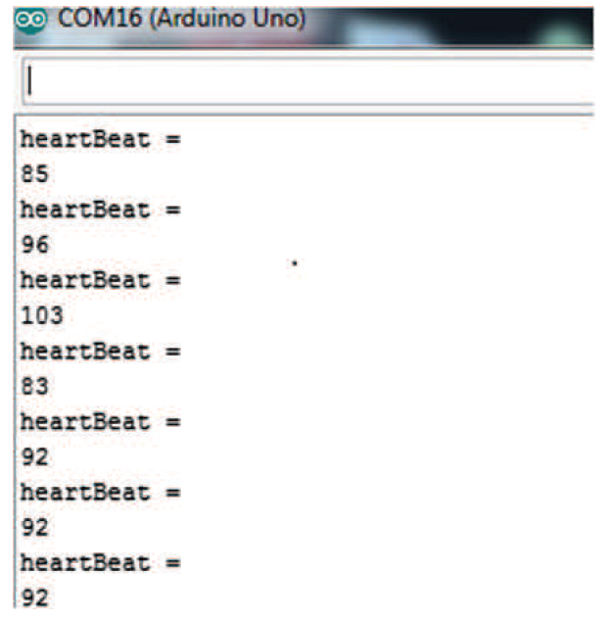
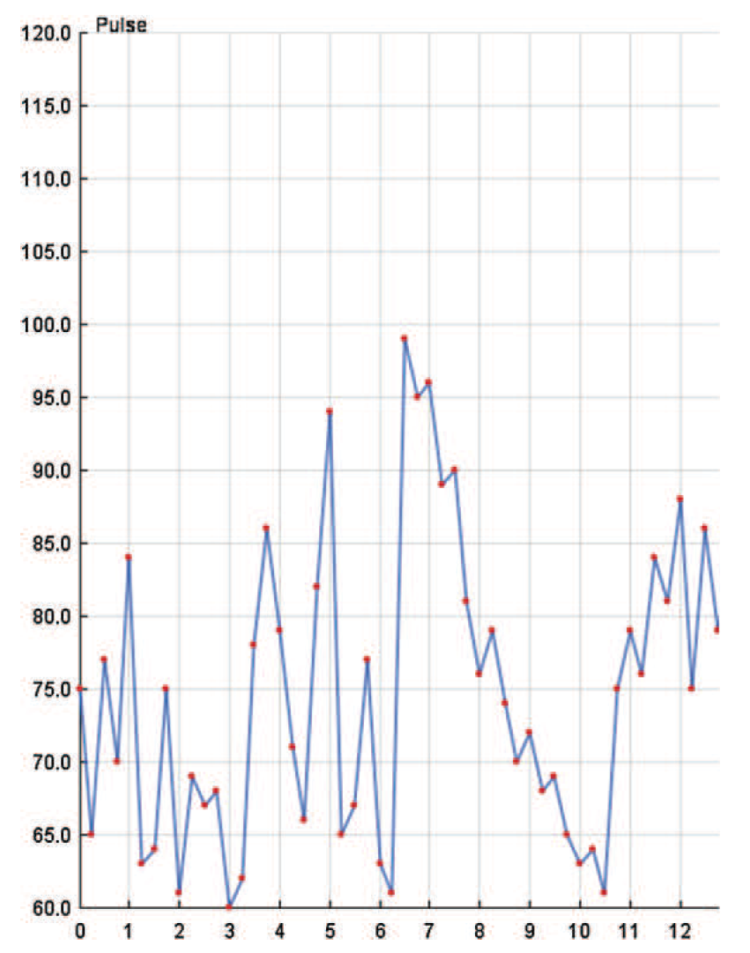
Heart beat measurement

Slide 23
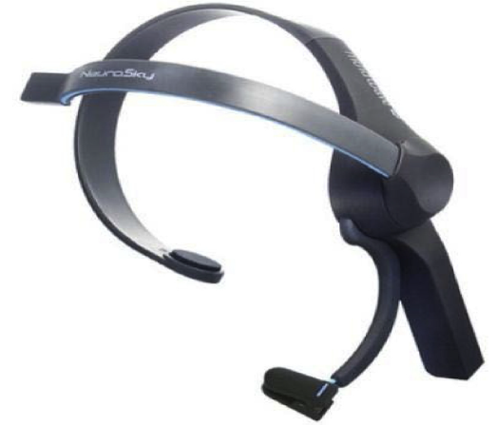
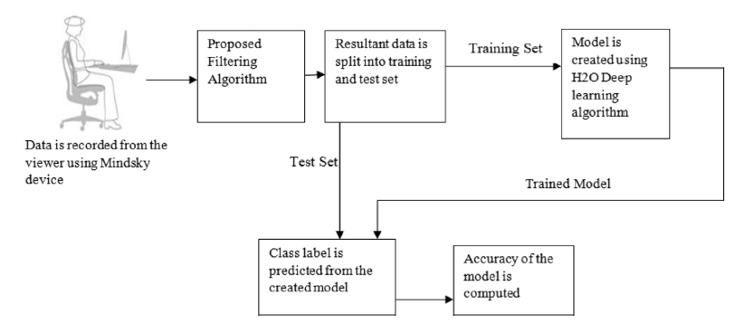
Brainwave device – EEG electrode

Slide 24
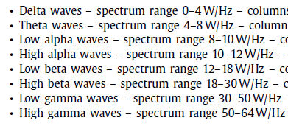
Wave Types observed

Slide 25
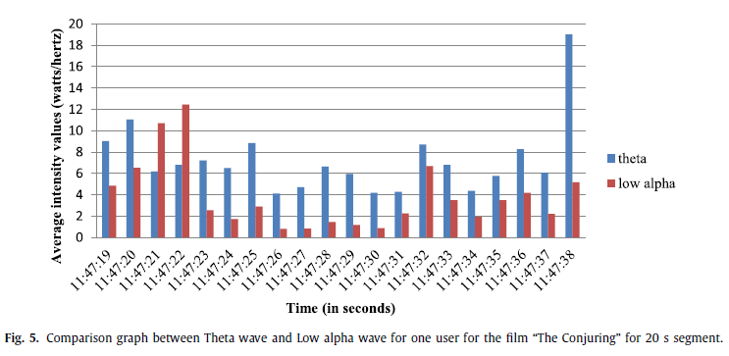
Analysis

Slide 26
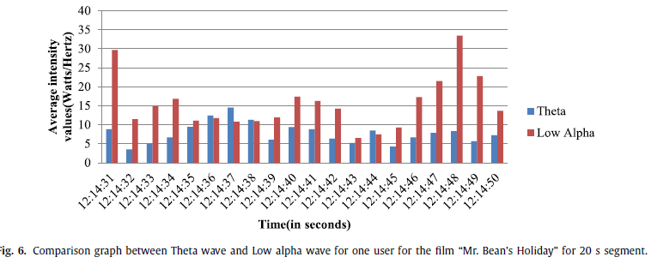
Analysis

Slide 27
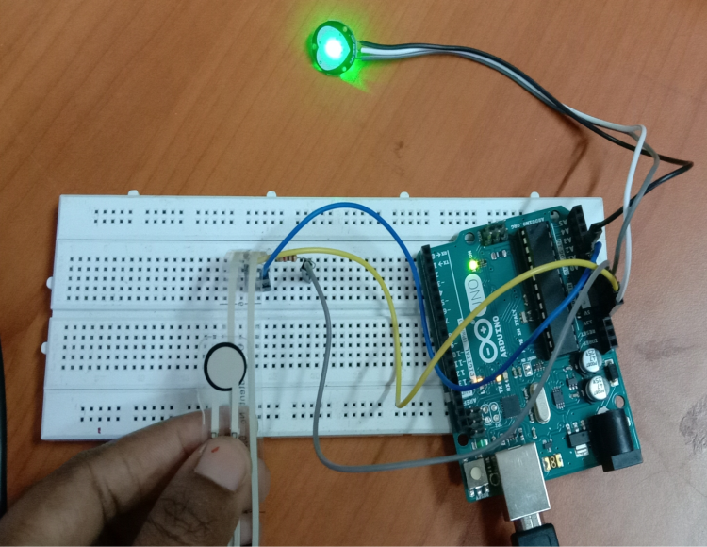
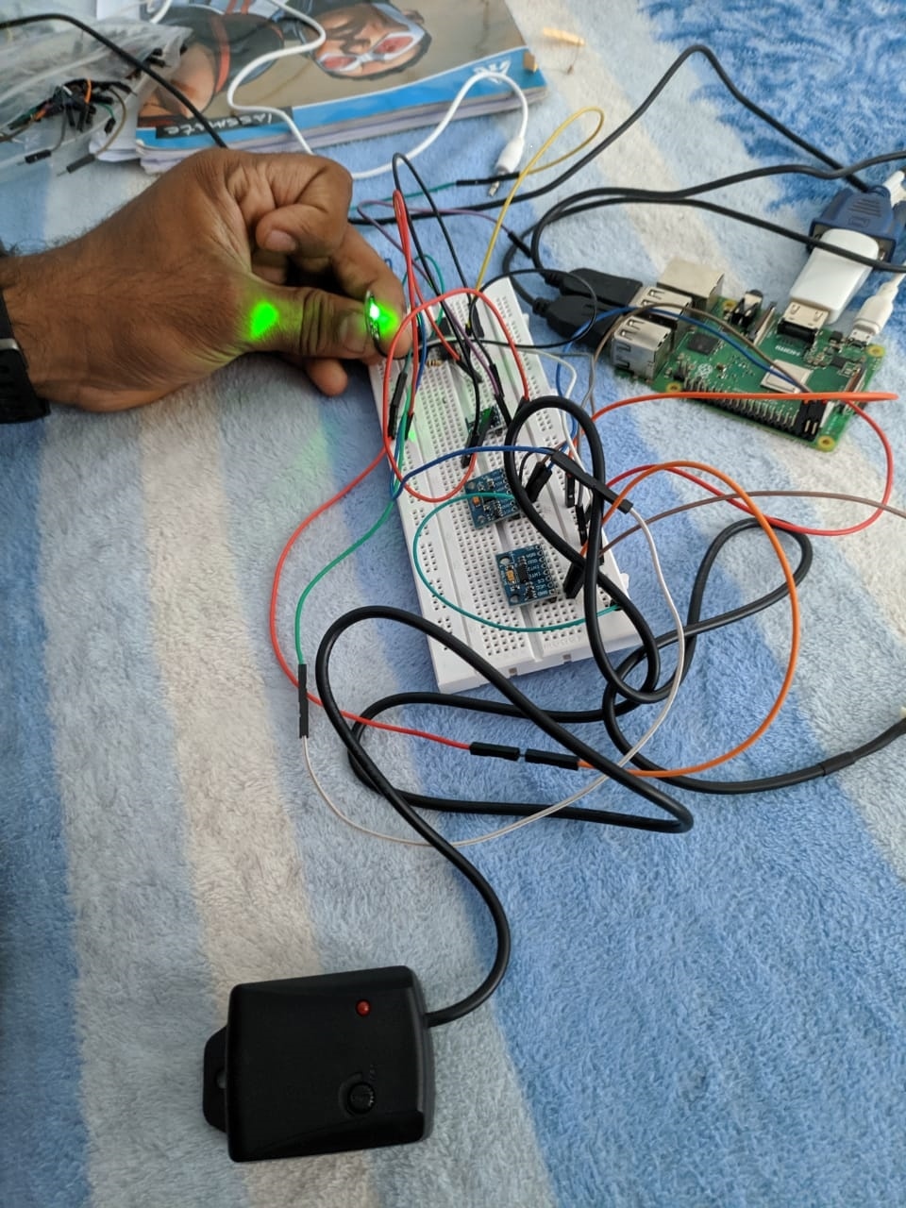
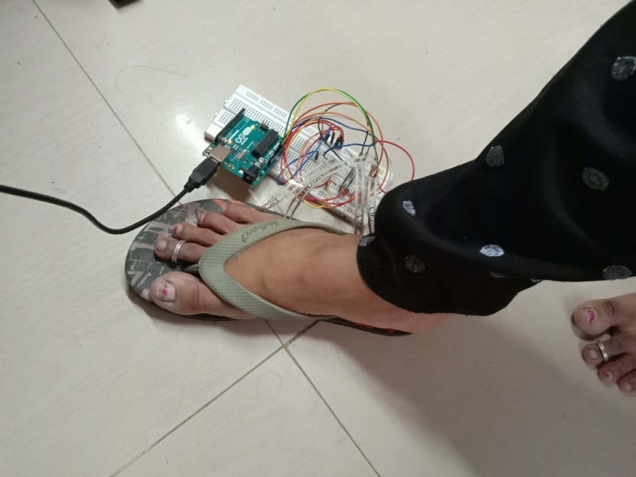
Multi-sensor IoT application
Pulse and Flexi sensor
Temperature, pulse, Vibration sensor
4- Flexi sensor

Slide 28



Slide 29

Data in Cloud

Slide 30

Data is converted into CSV

Slide 31

Data is converted into CSV

Slide 32

Machine Learning for Analysis
Outlier Detection using KNN

Slide 33


Machine Learning for analysis
Outlier Detection using SVM
PCA using SVM

Slide 34

Implementation tools

Slide 35



Footwear to study Parkinson affected patients (Gait Analysis) – TNSCST sponsored project

Slide 36
Challenges in Data Analytics using IoT Devices in Healthcare
Reliable data from sensors – Outlier detection and classification algorithms
Deployment of nodes
Heterogeneous devices
Network connectivity
Storage constraint

Slide 37
Thank You !

